Slide 1
ICA-Based Motion Correction
Jacob Nye

Slide 2
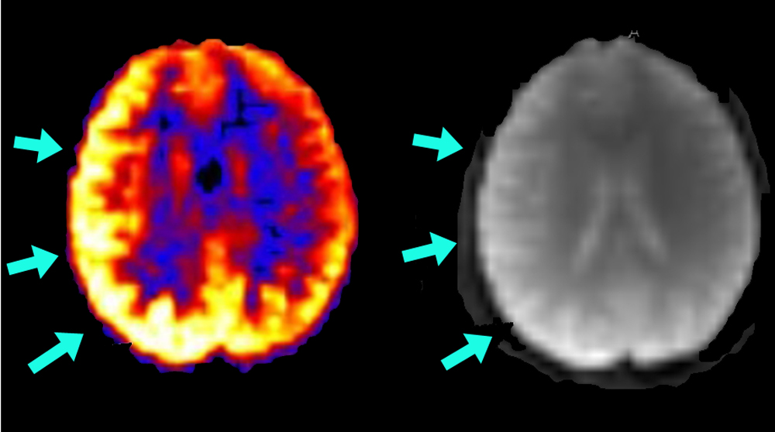
Background
Motion-related noise is a huge problem in fMRI studies that causes both activation effects and deactivation effects
While motion parameters can be regressed out using fMRI registration to reduce some motion artifacts, a lot of noise from motion artifacts are left after these steps.
Independent Component Analysis (ICA) is a data-based method that can be used to extract and remove motion-based noise because motion artifacts are usually either spatially or temporally independent

Slide 3
Method
Pipeline: Spatial ICA
Preprocessing: MELODIC
FLIRT Motion Correction
Slice Timing Correction
Co-registration: Functional -> T1 -> MNI_152 2mm
Removal of Motion-based Independent Components (ICs) – AROMA
1st Level & 2nd Level Analysis

Slide 4
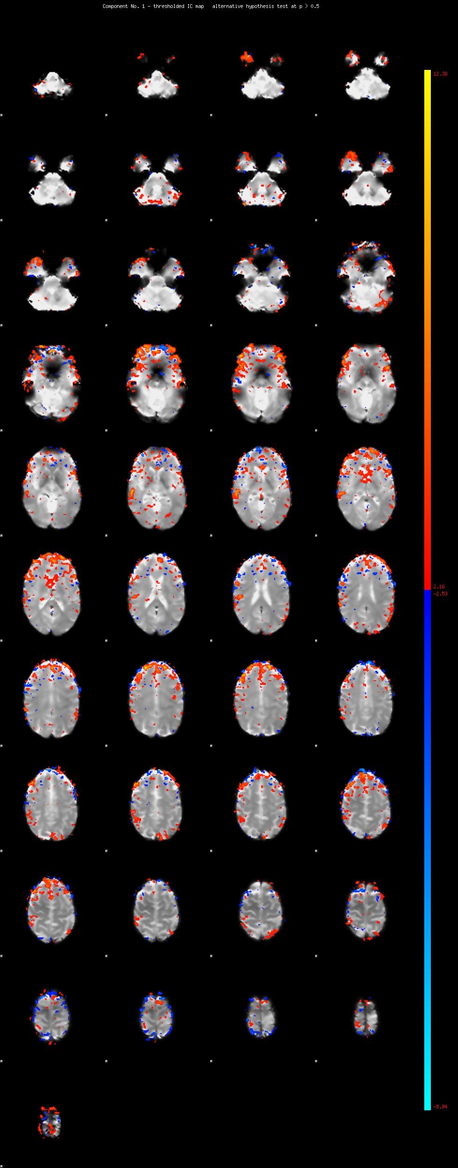
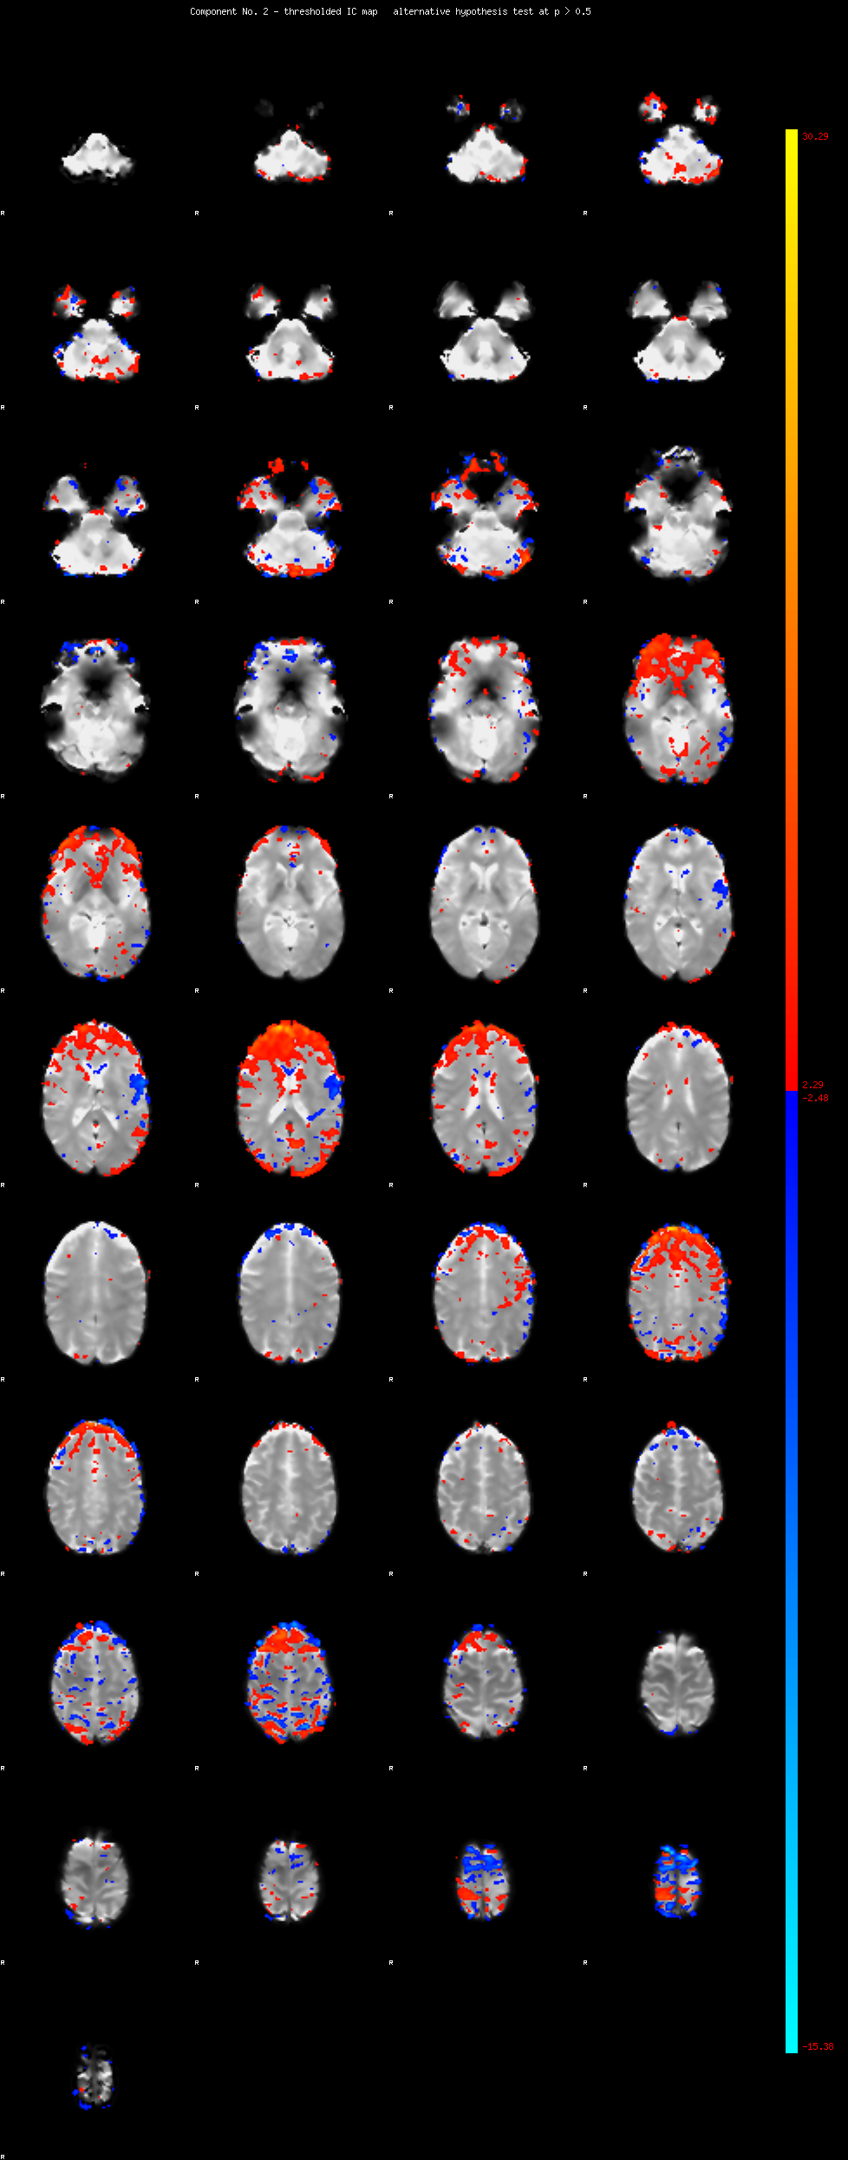
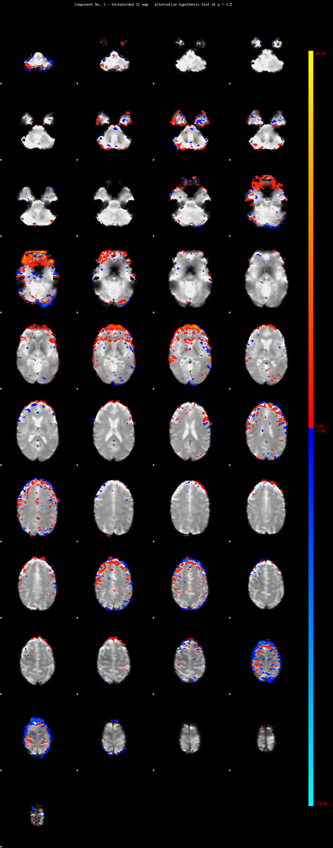
MELODIC Results
1st IC
2nd IC
3rd IC
A lot of the independent components extracted were motion related
As many as 57 of 59 ICs from one patient

Slide 5
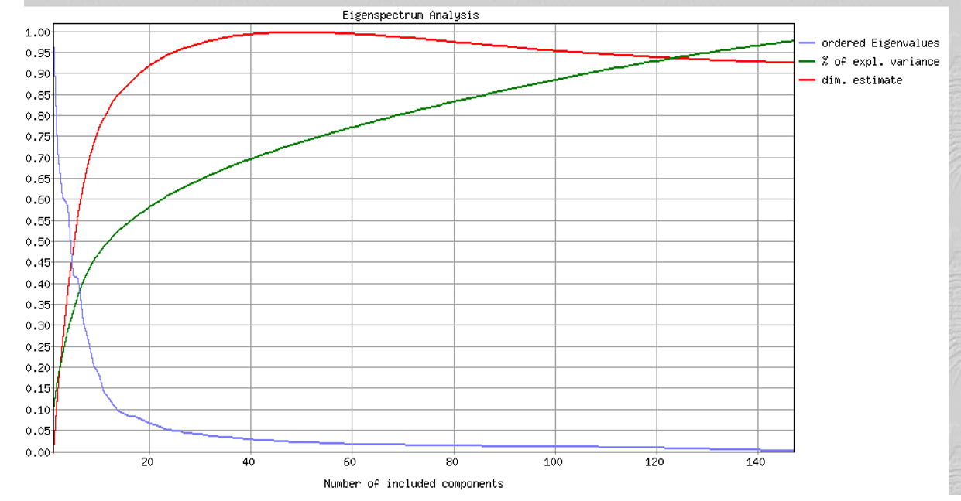
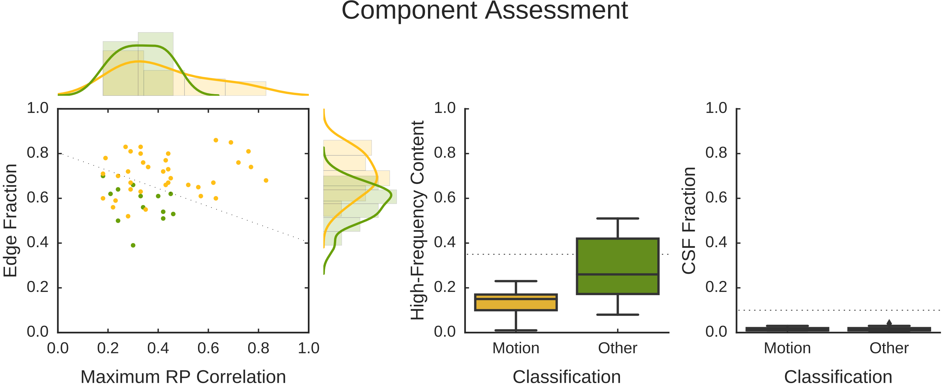

Slide 6
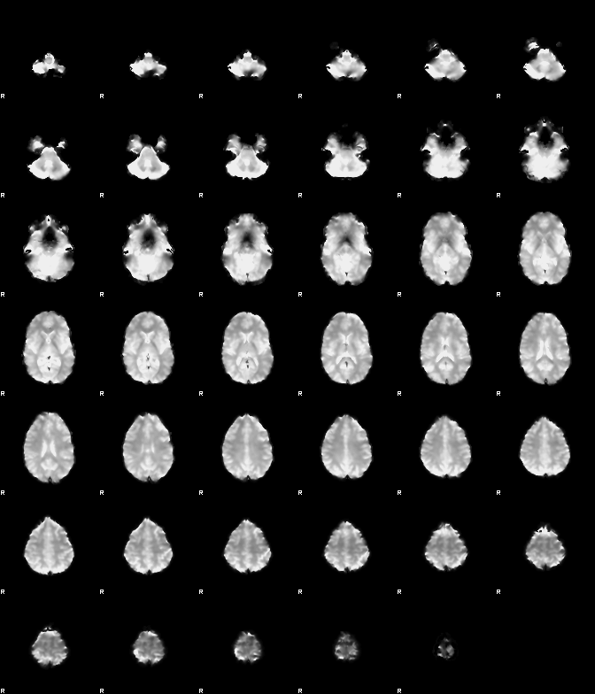
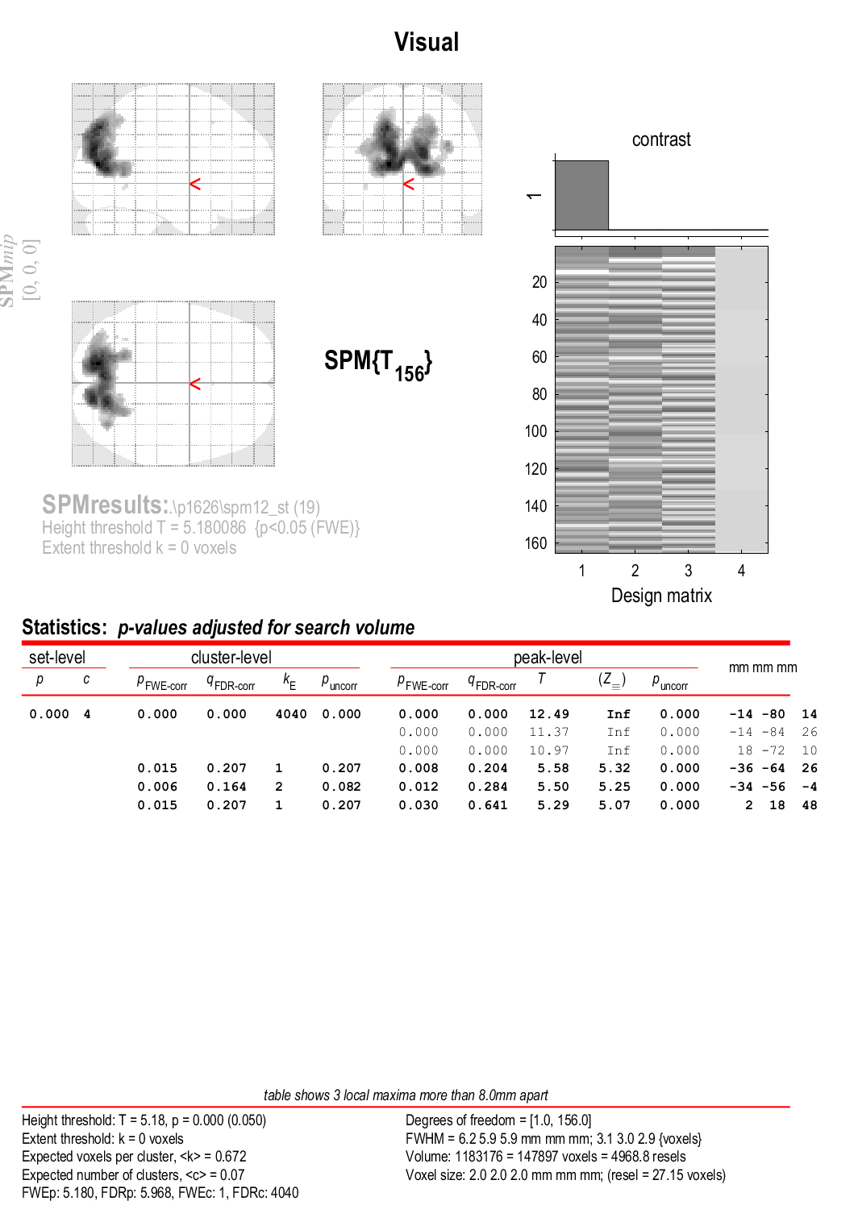
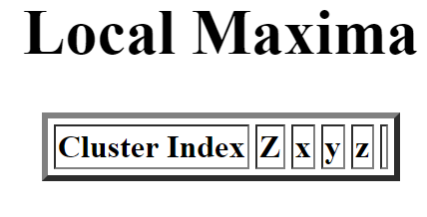
Contrasts – Normal vs. AROMA (Visual)

Slide 8
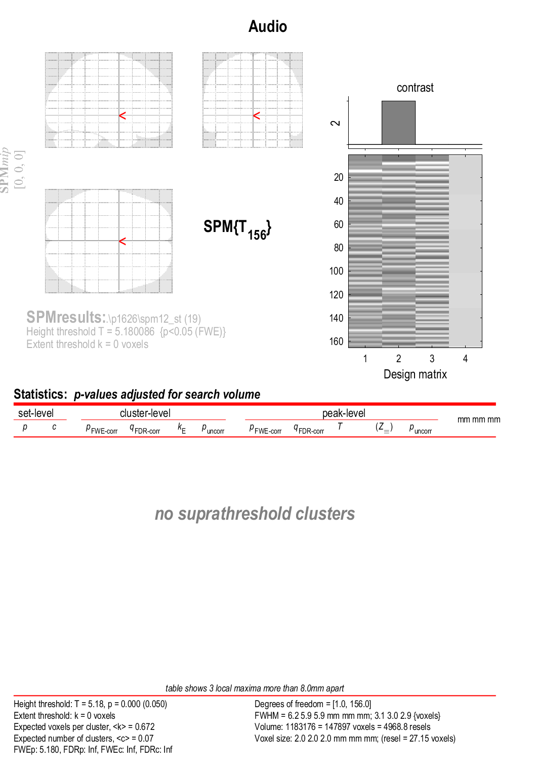
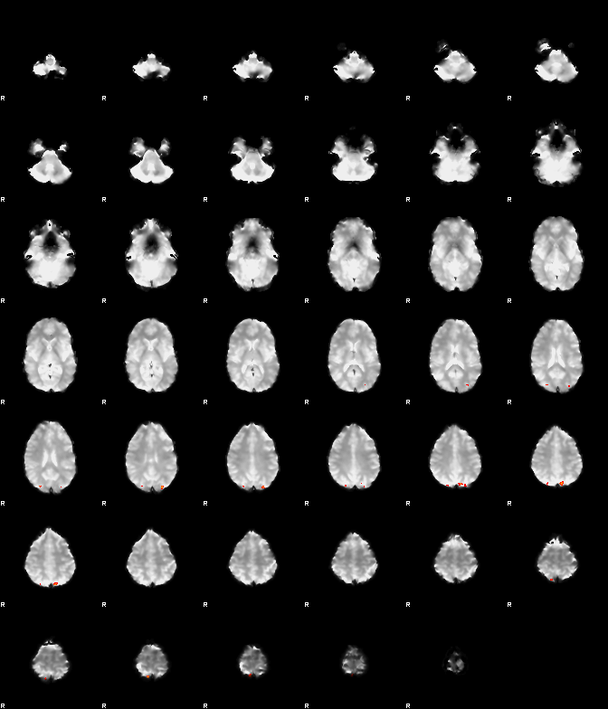
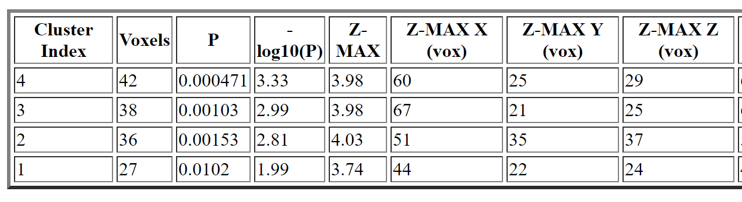
Contrasts – Normal vs. AROMA (Audio)

Slide 10
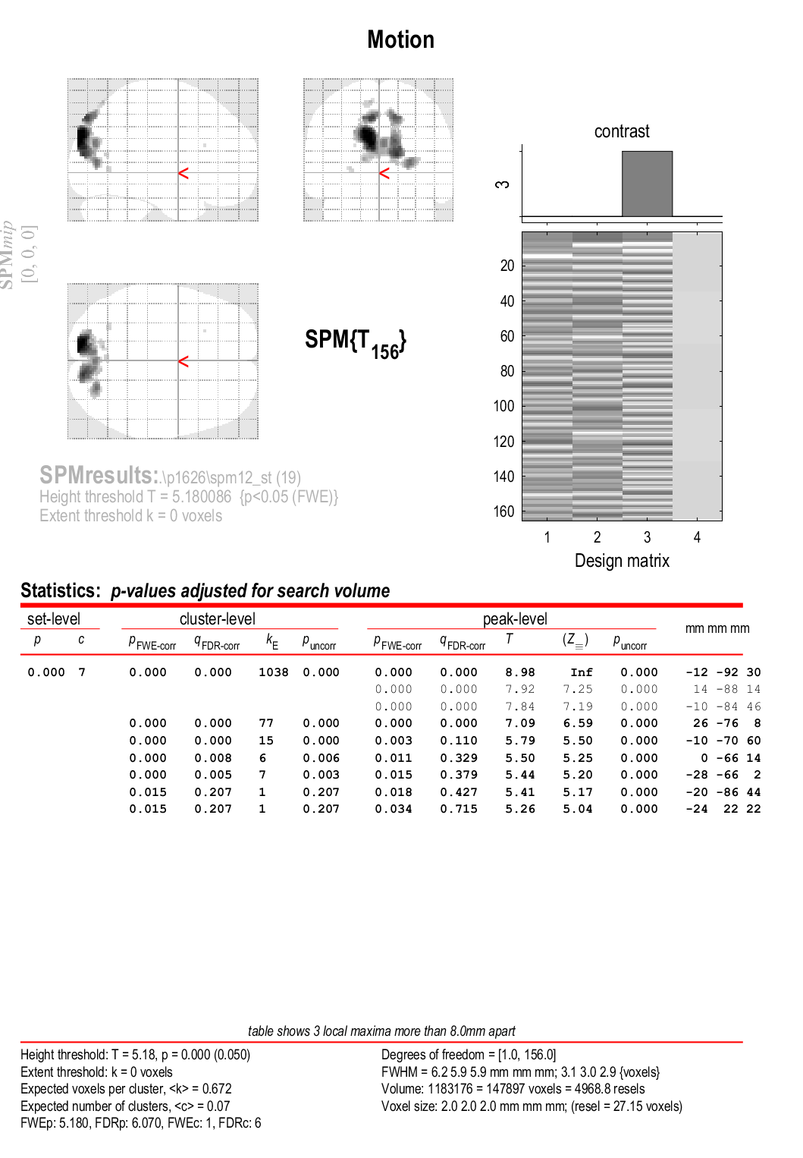
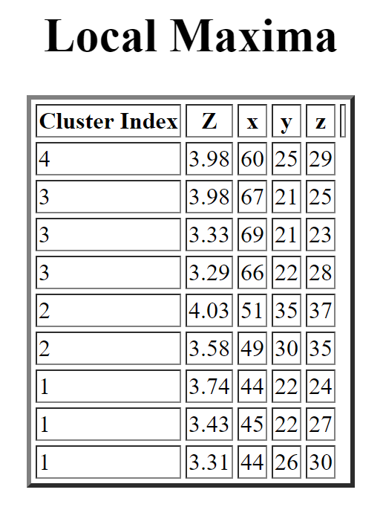
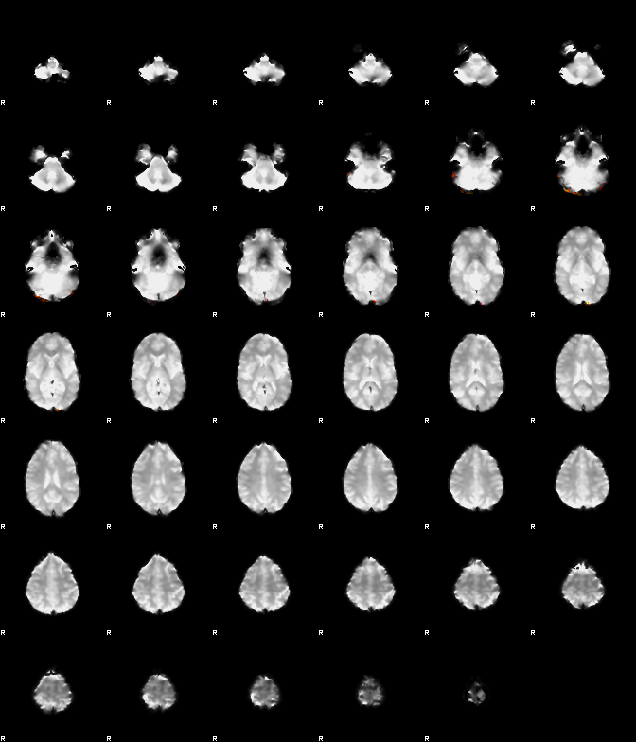
Contrasts – Normal vs. AROMA (Motion)

Slide 13
Discussion
Compared to SPM, AROMA removed a lot of the obvious motion-related artifacts present in the data
The overall amount of activation in the brain across all voxels was less than that in the SPM analysis
There were significant changes in activation because of noise removal by AROMA
For the paper, going to complete Temporal ICA using R and perform a dual-regression analysis to compare how each subject contributes to the group analysis based on the form of ICA used.

